Slide 1

Why Loan Default Prediction?
Critical for financial stability and reducing lender losses. Automates risk assessment efficiently.

Slide 2

Problem Statement
Loan Default Impact
Manual Evaluation
Significantly affects financial institutions' stability and assets.
Time-consuming, subjective, and prone to inconsistent decisions.
Objective
Problem Type
Develop ML model to predict loan approval status accurately.
Binary classification: Approved = 1, Not Approved = 0.

Slide 3

Dataset Overview
Source
Kaggle’s Loan Prediction Dataset, widely used and trusted.
Features
Includes applicant income, credit history, and more financial factors.
Availability
Public for research, enabling transparency and analysis.
Diversity
Data covers broad financial variables from various applicants.

Slide 4

Key Features
LoanID
Gender
Married
Dependents
Education
Self_Employed
ApplicantIncome
CoapplicantIncome
LoanAmount
Loan_Amount_Term
Credit_History
Property_Area
Loan_Status (Target variable)

Slide 5
Machine Learning Approach
Models Used
Key Metrics
Goal
Logistic Regression
Accuracy
Maximize accuracy while minimizing false negatives.
SVM (Support Vector Machines)
Precision
Decision Trees
Recall
F1-Score

Slide 6





Model Development Workflow
Data Preparation
Cleaning, preprocessing, and feature engineering.
Training
Model fitting with various algorithms and tuning.
Evaluation
Assessing performance to select the best model.
Deployment
Implementation and ongoing monitoring.

Slide 7

Benefits of Automated Prediction
Faster Processing
Speeds up loan approvals significantly.
Cost Efficiency
Reduces operational expenses with automation.
Consistency
Ensures objective and standardized decisions.
Risk Management
Improves detection and management of credit risk.

Slide 8

Conclusion and Next Steps
Optimize Model
Refine through additional data and feature enhancements.
Deploy Solution
Implement in real-world lending workflows.
Monitor & Improve
Track performance and update models regularly.

Slide 9
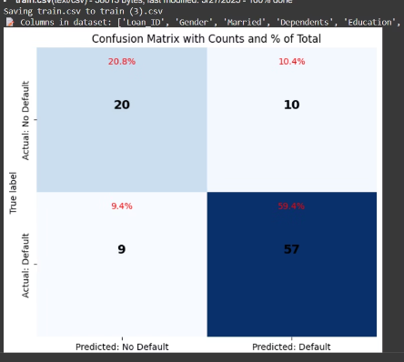
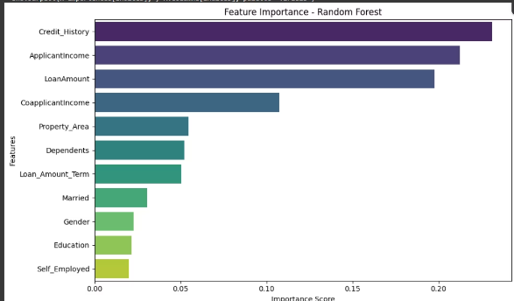
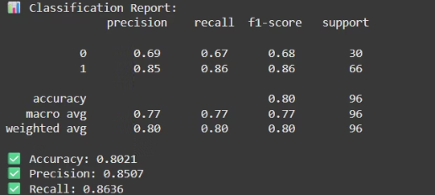
OUTPUT

